Slide 1

Employee Appreciation Based on Customer Satisfaction:
Team Members:
A.Koshik Kumar
B.Sreenu
V.Mounika
G.Rajubabu
B.Ravali

Slide 2

Problem:
The way you treat your employees is the way they treat your customers. According to a recent article, creating an employee recognition culture can increase employee retention by up to 31%. Employee recognition is the process of showing appreciation for an employee’s achievements, actions, and contributions. In some of the top companies, appreciation is given to the employees based on the customer feedback or satisfaction(chat process/ voice process). Analyzing all the feedback of each customer towards an employee contribution toward the work manually is a tedious job. so there should be a process that will analyze the best employee based on customer satisfaction.

Slide 3

Solution:
The main objective of this project is to appreciate the employee work based on analysis of customer feedback.
Design an application, where the HR/ User can upload the feedback report of all the employees.
The appreciation analysis of each employee displayed on the Web application in the form of Bar charts.
Save all the feedback from customers for particular employees in the database.
Stream all the feedbacks from the database and give them to Amazon Comprehend service
Count the number of positive, neutral and negative feedbacks of each employee
Display the count on the dashboard
Rate the employee performance based on the number of positive feedbacks

Slide 4

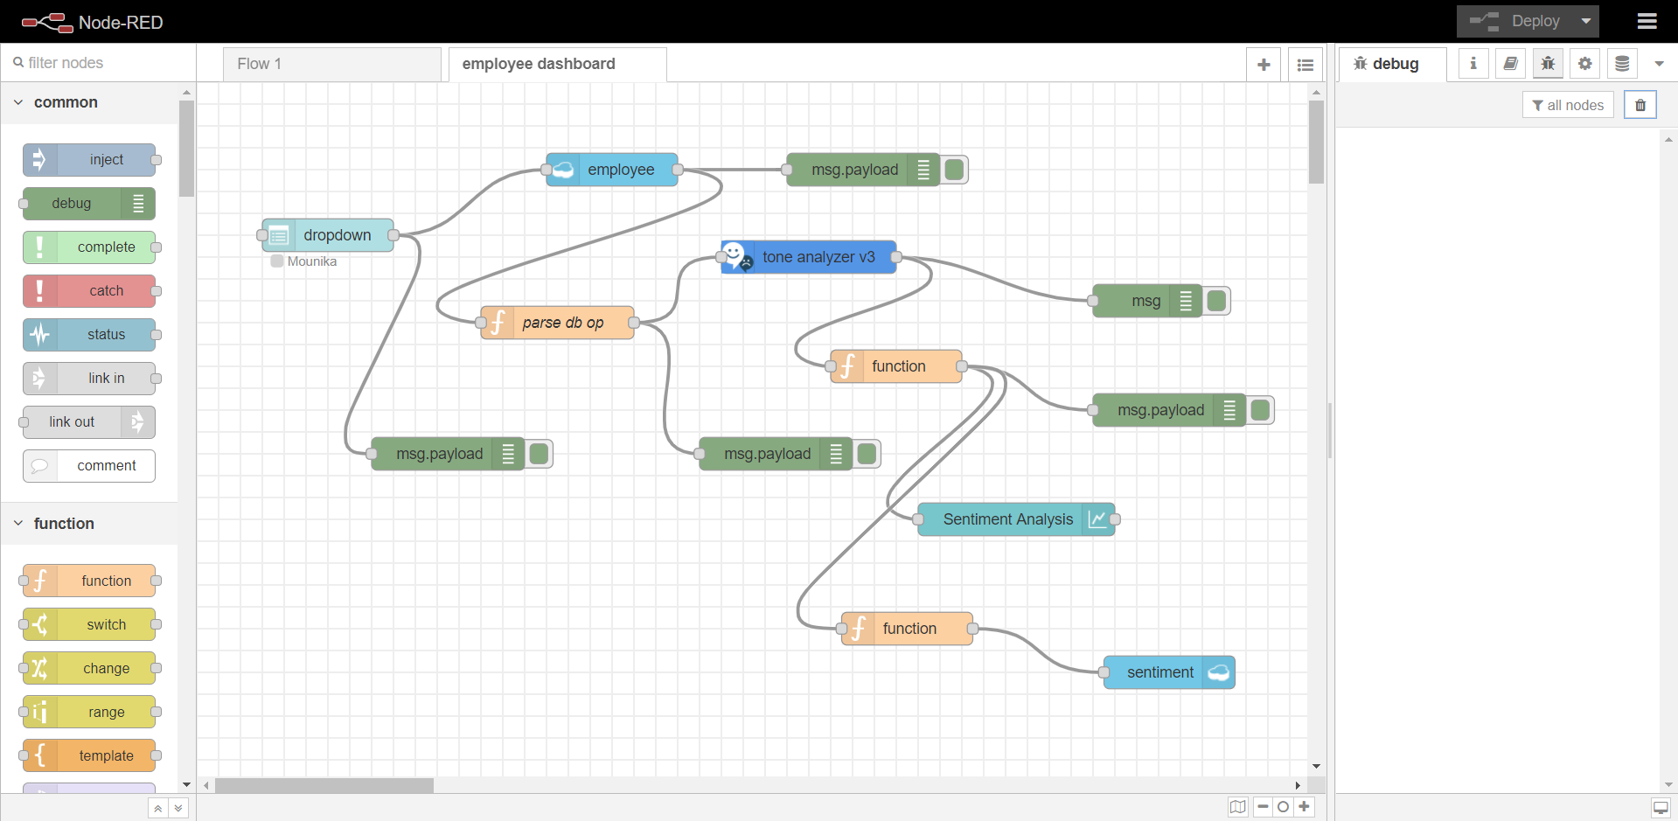
NODE – RED FLOW:

Slide 5
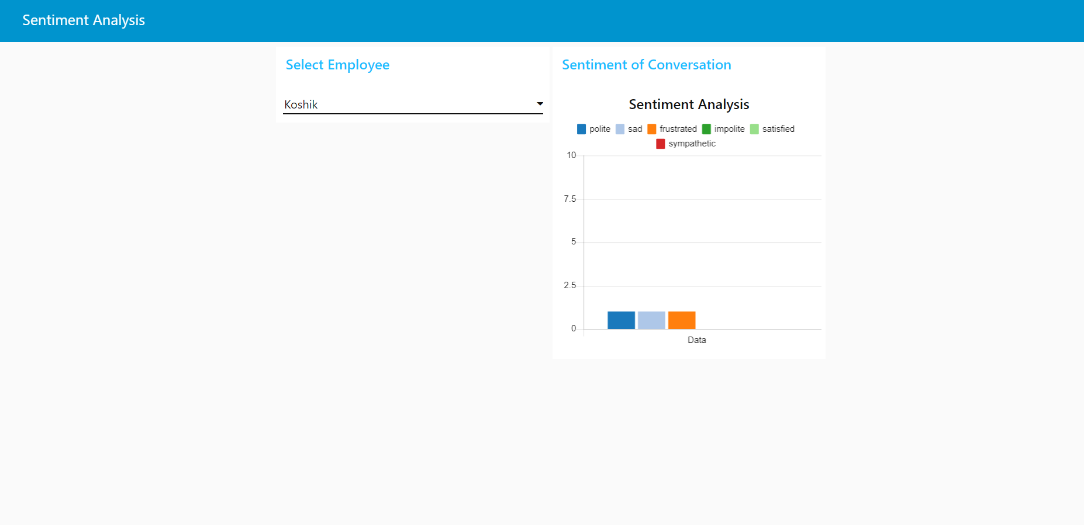
Sentiment Analysis:

Slide 6
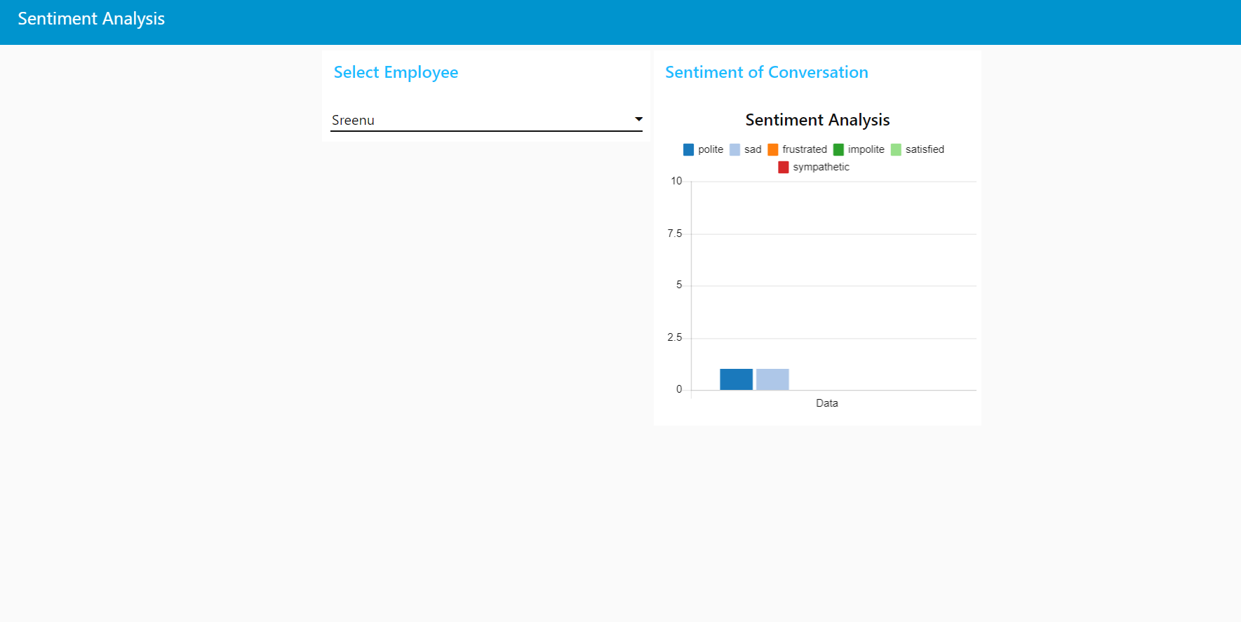

Slide 7
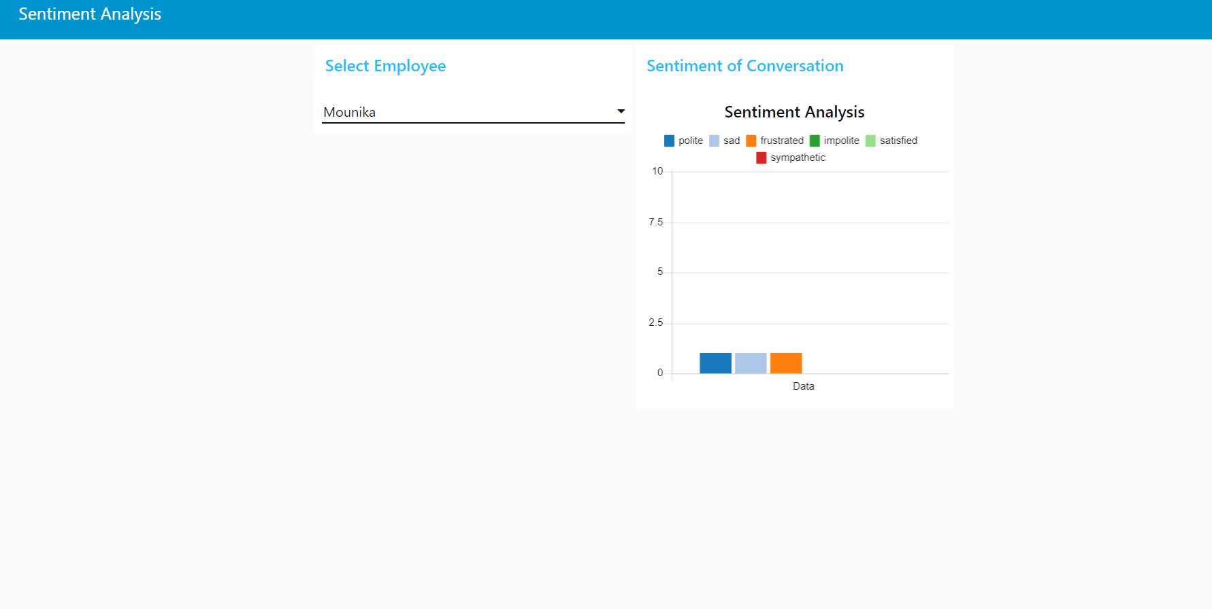

Slide 8
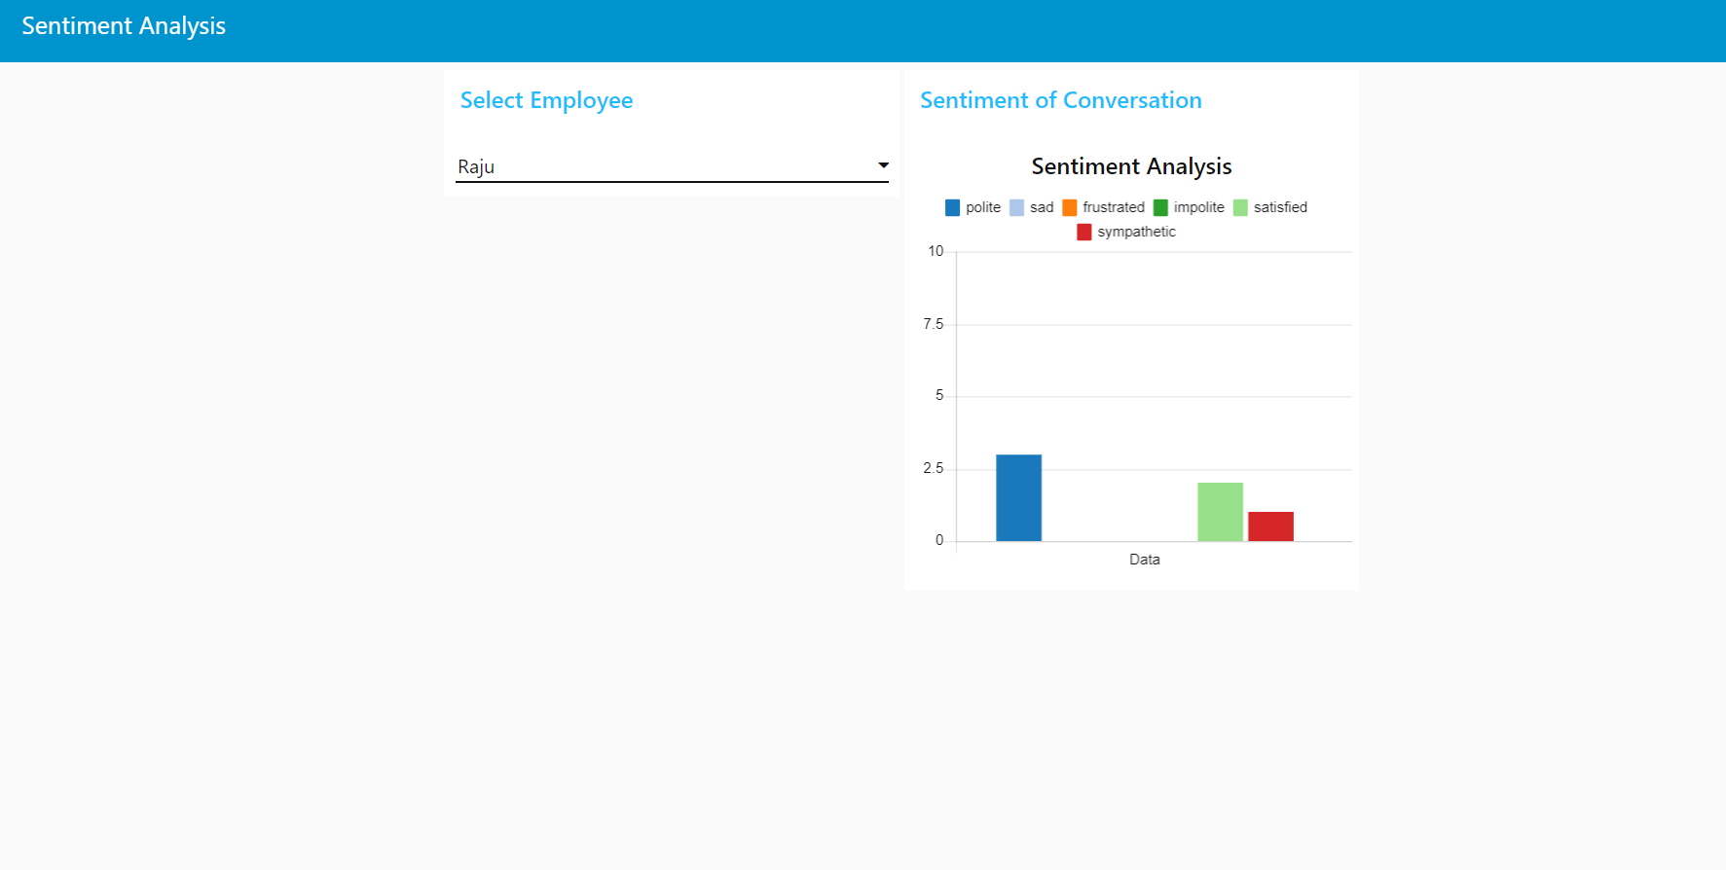

Slide 9
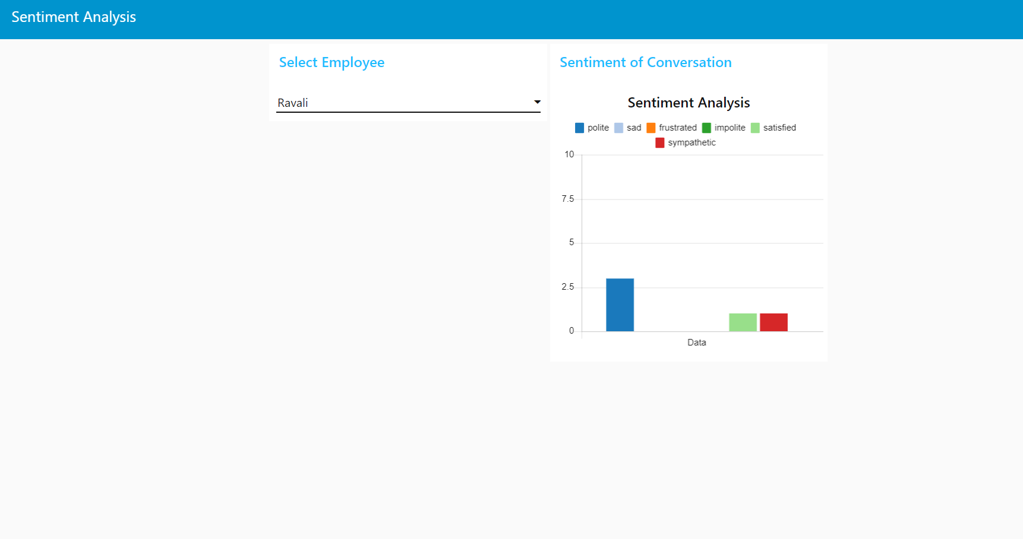

Slide 10

THANK YOU

